Slide 1
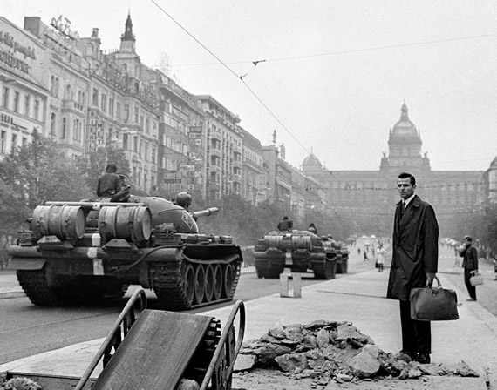
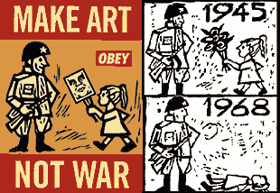
Czechoslovakia: ‘The Prague Spring’, 1968

Slide 2
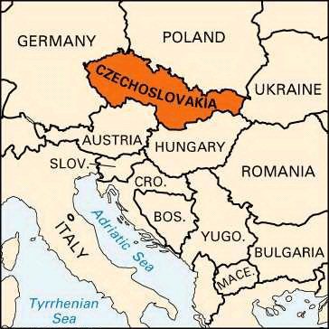
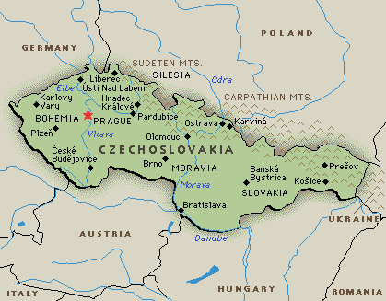
Background
Pague is the capital of Czechoslovakia, a nation formed as part of the Treaty of Versailles.

Slide 3
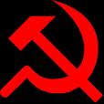
Background
1948: Czechoslovakia becomes a communist state
By 1967, many people felt their communist leaders were out of touch with the problems they were facing
  There were complaints that the Soviet Union was exploiting the people.
  None of the reforms that the government introduced worked.
  Czechoslovakia had suffered a recession in 1961 under the rule of Antonin Novotny.

Slide 4
Prague Spring
In October 1967 students demonstrated against Novotny.
January 1968, new leader of the Czech communist party was elected: Alexander Dubcek.
This began what was known as the Prague Spring. A brief period of liberalisation under Dubcek.

Slide 5
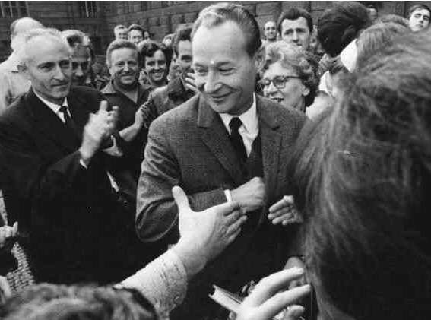

Slide 6
Prague Spring reforms
Relaxed government control of industry – left decision making to managers and workers
Ended censorship of the press
Czech’s were free to travel to other countries
Czech’s were allowed to hold political meetings inside Czechoslovakia
The Communist Party held meetings with non communists-However would remain the major party in Czechoslavakia.
Remained a member of Warsaw pact

Slide 7
Reaction of the USSR
Brezhnev (who had replaced Khruschev in October ‘64) was alarmed by what was happening
Soviet’s held military manoeuvres near Czech border
Warsaw pact countries held military exercises inside Czechoslovakia
Dubcek met with Brezhnev and other communist leaders, promising that the Communists would remain in control, they would remain in the Warsaw pact and that the Czech press would not criticise the USSR

Slide 8
Reaction of the USSR
Brezhnev was not convinced and was afraid that Dubcek’s reforms might be copied by other Eastern Bloc countries
Both Romania and Yugoslavia assured Dubcek of their support
The Brezhnev doctrine: whenever "socialism is threatened", the Soviet Army has the duty to intervene

Slide 9
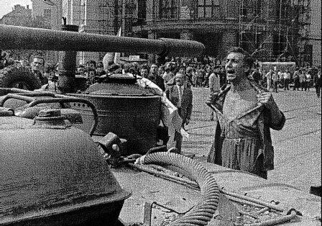
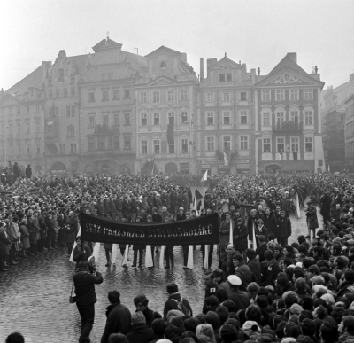
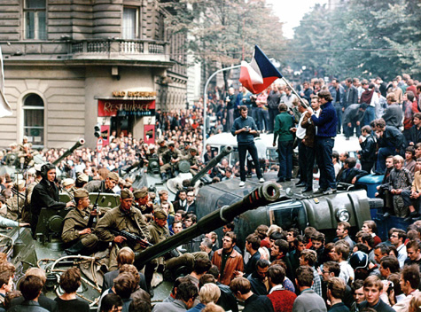

Slide 10
Brezhnev acts
August 21st 1968, 500 000 Warsaw pact troops marched in and took control of Prague and other Czech cities
Dubcek was captured and sent to Moscow (in the USSR)
Dubcek returned to Czechoslovakia as First Secretary of the Party and announced his talks had been comradely. He then did as instructed and announced that all reforms were ending.
In April 1968 Dubcek was removed from office.

Slide 11
Consequences
Some 300 000 Czech professionals left for the West
The whole nation was forced to approve the invasion
Those who collaborated received modest consumerist rewards
The ethos of the "normalisation" period imprinted itself most strongly on Czechoslovak society
Only a small ghetto of dissidents remain.

Slide 12
Significance
The Prague Spring had proved that the Soviet Union was not willing to contemplate any member of the Warsaw Pact leaving the Eastern alliance.
The tanks that rolled through the streets of Prague reaffirmed to the West that the people of Eastern Europe were oppressed and denied the democracy that existed in Western Europe.
However, to Moscow, it was a signal that under Brezhnev, any member state that appeared to be seduced or manipulated by western influences, would receive the full military support of the Warsaw Pact denying the spread of capitalism

